Slide 1
Tailoring Identity for You
Romek Szczesniak

Slide 2
Identity in Practice – A Patchwork Quilt
Document reading
Document scanning and verification
Biometrics – Face, Fingerprint, Iris, Retina, etc.
Identity system registration and validation
Network security
Internal and External Audit
Insurance
Application

Slide 3
Document Reading...
Electronic scanning to PDF
How do we scan documents in the new world?
  Secure Document Reader
  Photocopier
  Mobile Phone Camera
  NFC
Local storage?
Ultra Violet and Infrared Reading?

Slide 4
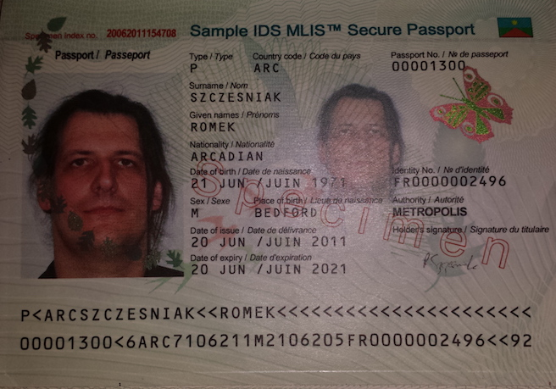
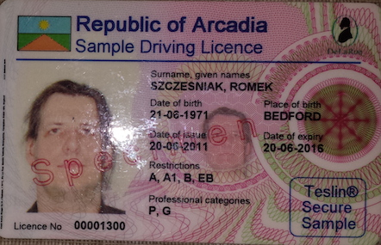
Document Verification
How do you detect fakes?

Slide 5
Biometrics
Which Biometrics are Usable?
  Face, finger, iris, retina
  How do we obtain these in general use
  Liveness to prove the person is real

Slide 6
Network Security
Making sure the underlying networks that any identity transactions flow over are secure
Disguising Client and Server
Penetration Testing
Encrypted networks
Monitoring Information Flow

Slide 7
Internal and External Auditing
We support PCI, ISO 27001 and ISO 9001
We provide guidance and training to perform internal and external vulnerability testing
We work with external auditors to support UK auditing standards for identity systems

Slide 8
Insurance
We are not insurers, but we can show you where and how to lower your risk levels
We provide identity systems that support and exploit UK Law

Slide 9
Putting It All Together
When I buy a beer electronically, I can be identified by:
  Government issued document
  Biometric
  Device used
  Time of transaction
  Liveness of Me
  Monetary token to pay for beer with!
Transaction must be performed in < 0.5secs

Slide 10
What We Do?
We can do all of the previous ideas
We can improve in how they work
We can provide bespoke ideas
We challenge current ideas to do better
We look outside the box
We innovate in identity solutions

